Slide 1
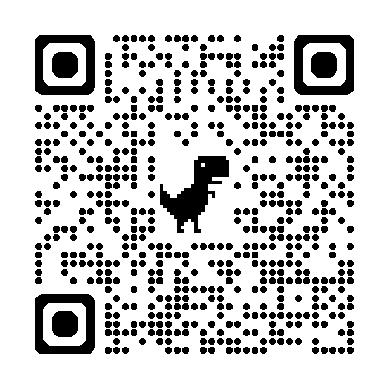

Studying the Educational Influence of Adaptive Learning Tools
Presented by Satanshu Mishra
Supervised by Dr. Abdallah Mohammed
References
Code
Repository

Slide 2
Chapter 1
The Problem
References
Code
Repository

Slide 3
The Problem
uLearn Adaptive Learning Tool: System designed to personalize the learning experience for students.
Accessible at ulearn.ok.ubc.ca.
References
Code
Repository

Slide 4
What are the current trends of adaptive learning systems in CS Education?
Research Questions
To what extent does the learning tool implementation enhance learners’ understanding and performance in a first-year CS course?
What future recommendations can be leveraged to advance CS1 education through adaptive learning systems?
References
Code
Repository

Slide 5
Chapter 2
Theoretical Background
References
Code
Repository

Slide 6
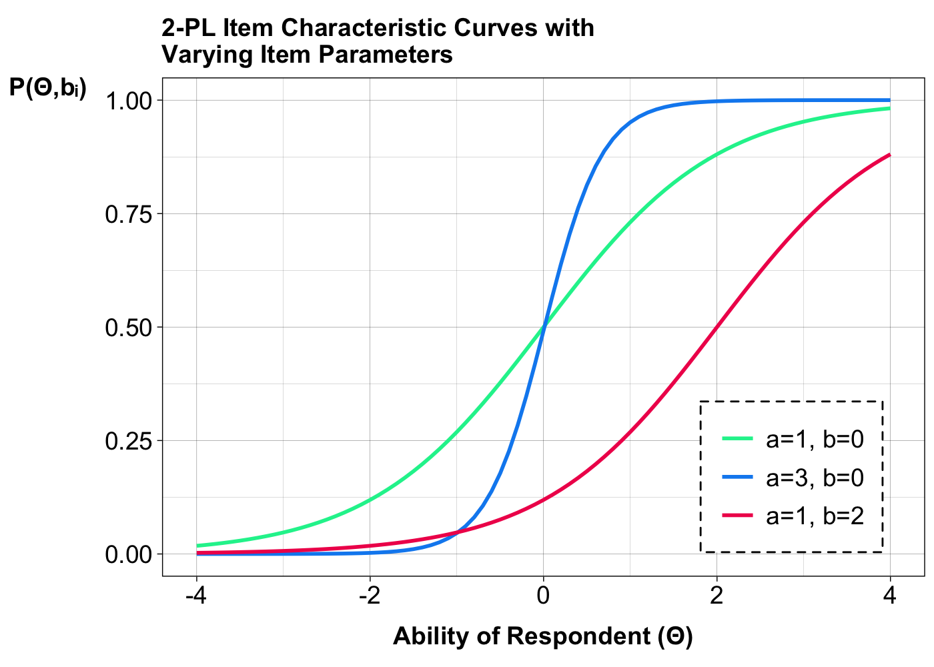
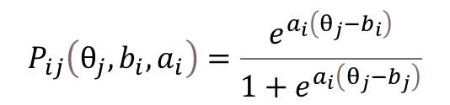
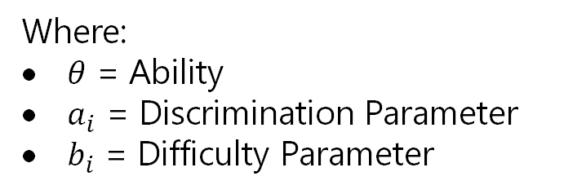
Item Response Theory (IRT)
$$P_{ij}\left(θ_{j},b_{i},a_{i}\right)=\frac{e^{a_{i}\left(θ_{j}−b_{i}\right)}}{1+e^{a_{i}\left(θ_{j}−b_{j}\right)}}$$
Where:
$θ$ = Ability
$a_{i}$ = Discrimination Parameter
$b_{i}$ = Difficulty Parameter
Figure 2.3: Item Characteristic Curves for 2-Parameter Logistical Model with Varying Item Parameters. The Green curve acts as the base curve for this plot. The Blue curve shows the effect of increasing the Discrimination parameter. The Red Curve shows the effect of increasing the Difficulty parameter.
References
Code
Repository

Slide 7
Chapter 3
The Machine Learning Model
References
Code
Repository

Slide 8
Select a set of questions that is most relevant for a student based on question difficulty and the student’s understanding level.
The Goal
References
Code
Repository

Slide 9



The BIG Three
Mastery: Measure of student competency in each question topic and category. Calculated at every attempt.
Column Name | Description
studentID | Foreign Key to Individual Student ID
topicID | Foreign Key to Individual Question Topic ID
categoryID | Foreign Key to Individual Question Category ID
mastery | Mastery Level for Topic– Category pair
difficultyOffset | Difficulty Offset calculated using IRT
Range: $−1.7$ $↔$ $1.7$
Correct: $+=$ $0.05$
Incorrect: $−=$ $0.04$
Difficulty Offset: Calculated using 2-PL IRT Model. Measure of a student’s ability to answer questions from a specific topic. Calculated at the end of every completed quiz.
Table 3.1: Structure of the studentKnowledge relation. Only relevant columns are shown.
Column Name | Description
assignedDifficulty | Pre-Assigned Question Difficulty
modifiedDifficulty | Personalized Question Difficulty based on Performance Statistics
Range: $−2.5$ $↔$ $2.5$
Table 3.2: Structure of question relation. Only relevant columns are shown.
References
Code
Repository

Slide 10
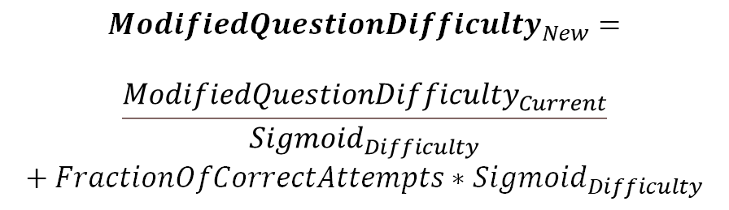


The BIG Three
Modified Question Difficulty: Measure of global student performance on a specific question.
Column Name | Description
studentID | Foreign Key to Individual Student ID
topicID | Foreign Key to Individual Question Topic ID
categoryID | Foreign Key to Individual Question Category ID
mastery | Mastery Level for Topic– Category pair
difficultyOffset | Difficulty Offset calculated using IRT
Range: $−2.5$ $↔$ $2.5$
$${Sigmoid}_{Difficulty}= \frac{1}{1+e^{10−numberOfAttempts}}$$
Table 3.1: Structure of the studentKnowledge relation. Only relevant columns are shown.
$${ModifiedQuestionDifficulty}_{New}=$$
$$\frac{{ModifiedQuestionDifficulty}_{Current}}{{Sigmoid}_{Difficulty}}$$
$$+ FractionOfCorrectAttempts∗{Sigmoid}_{Difficulty}$$
Column Name | Description
assignedDifficulty | Pre-Assigned Question Difficulty
modifiedDifficulty | Personalized Question Difficulty based on Performance Statistics
Table 3.2: Structure of question relation. Only relevant columns are shown.
References
Code
Repository

Slide 11
A Practical Example
-10.0
0.0
10.0
References
Code
Repository

Slide 13
A Practical Example
-10.0
0.0
10.0
-12.5
12.5
Question Difficulty Range
References
Code
Repository

Slide 14
A Practical Example
Mastery + Difficulty Offset Range
-12.5
-10.0
-4.2
0.0
4.2
10.0
12.5
Question Difficulty Range
References
Code
Repository

Slide 15
A Practical Example
Mastery + Difficulty Offset Range
-12.5
-10.0
-6.2
-4.2
-2.2
0.0
2.2
4.2
6.2
10.0
12.5
Question Difficulty Range
References
Code
Repository

Slide 16
A Practical Example
Mastery + Difficulty Offset Range
-12.5
-10.0
-6.2
-4.2
-2.2
0.0
2.2
4.2
6.2
10.0
12.5
Question Difficulty Range
References
Code
Repository

Slide 17
A Practical Example
Mastery + Difficulty Offset Range
-12.5
-10.0
-4.2
0.0
4.2
10.0
12.5
Question Difficulty Range
References
Code
Repository

Slide 18
A Practical Example
Mastery + Difficulty Offset Range
-12.5
-10.0
-4.2
0.0
4.2
10.0
12.5
Question Difficulty Range
References
Code
Repository

Slide 19
Chapter 4
uLearn
References
Code
Repository

Slide 20
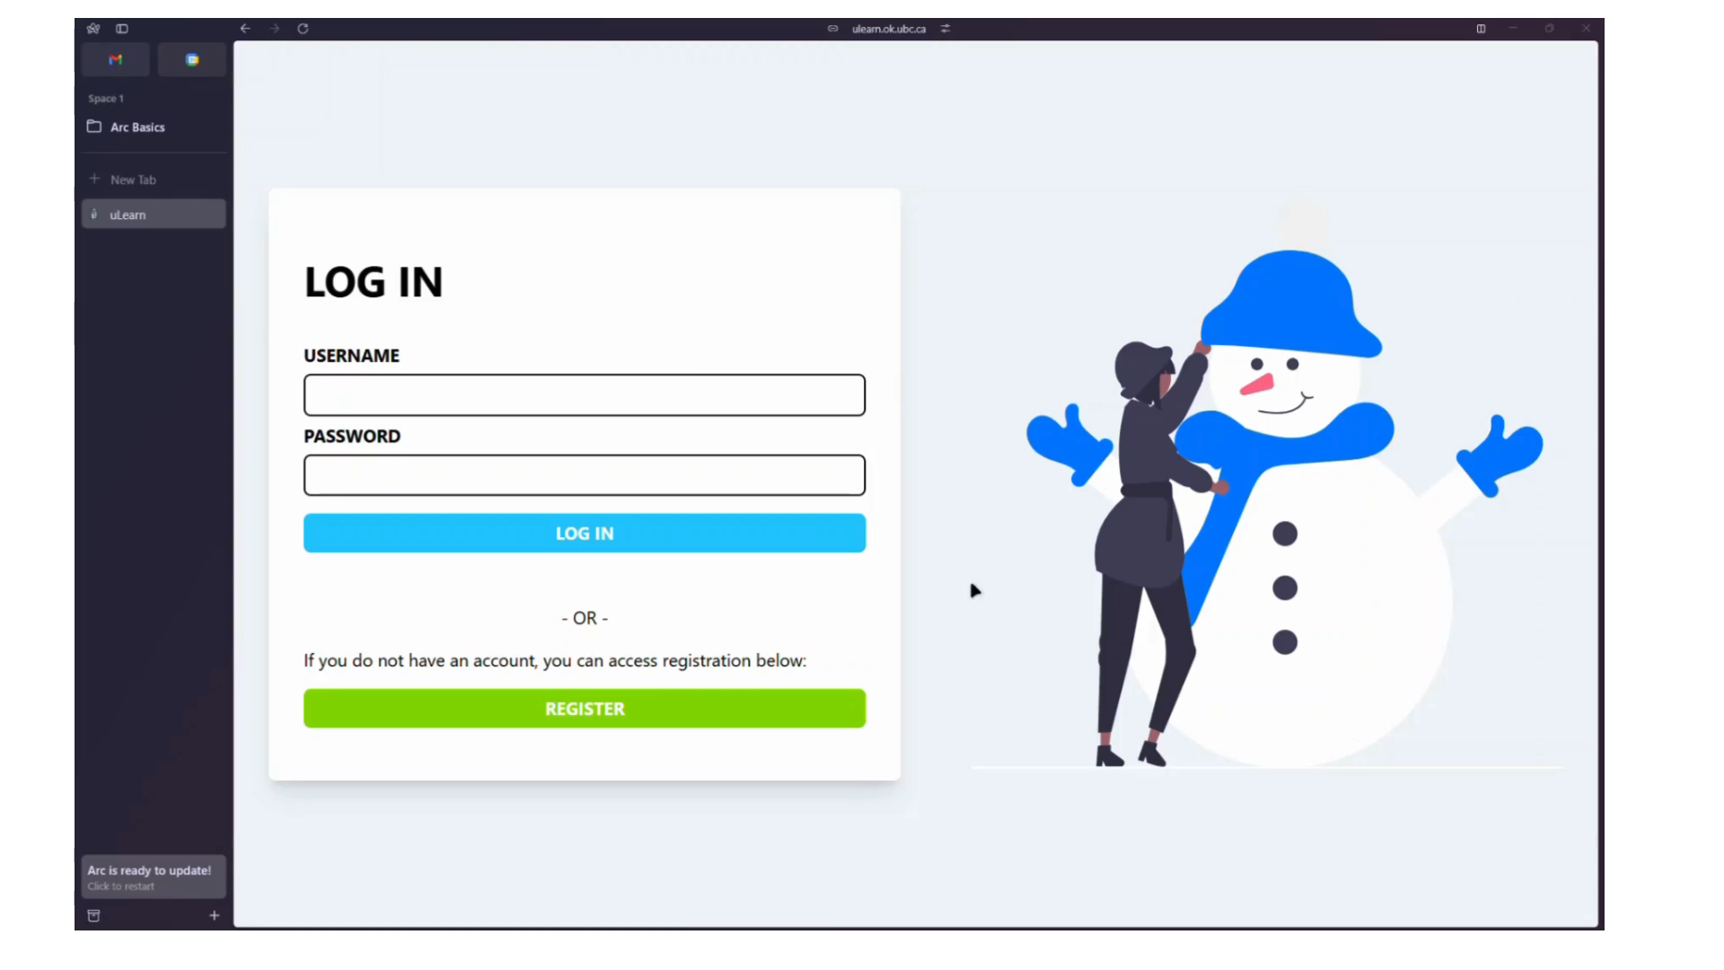
System Demonstration
References
Code
Repository

Slide 21
Chapter 5
Case Study
References
Code
Repository

Slide 22
Study Details
This system was implemented within a first-year introductory Computer Science.
Four question topics were developed: Error Handling, I/O, Recursion, and Lists, Queues & Stacks
Each topic encompassed five categories: Remembering, Understanding, Applying, Analyzing, Evaluating, and Creating.
A quiz consists of twenty questions.
Most participants intended to major in Computer Science, while others aimed for majors in Mathematics, Physics, Biochemistry and Molecular Biology, Management, Philosophy, Engineering, or Data Science.
References
Code
Repository

Slide 23
Chapter 6
Results & Findings
References
Code
Repository

Slide 24
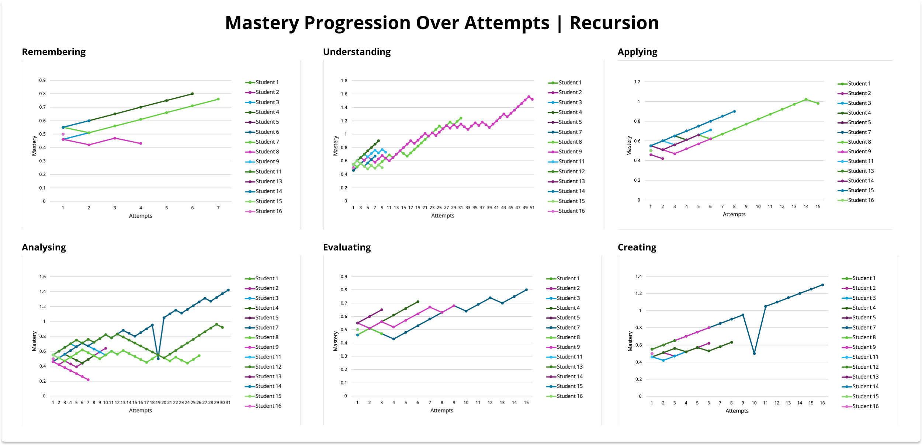
Results & Findings
References
Code
Repository

Slide 25
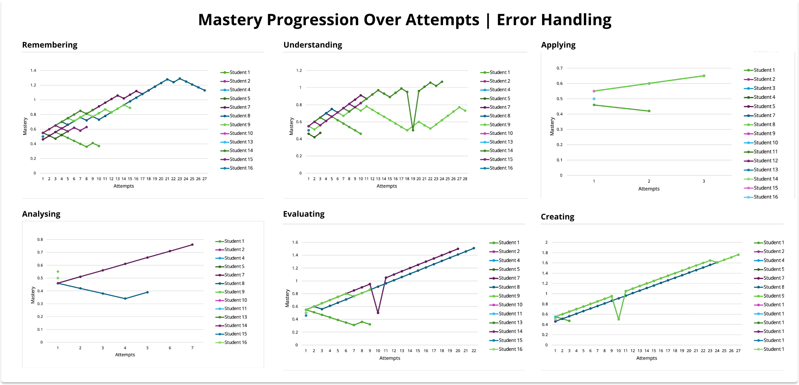
Results & Findings
References
Code
Repository

Slide 26
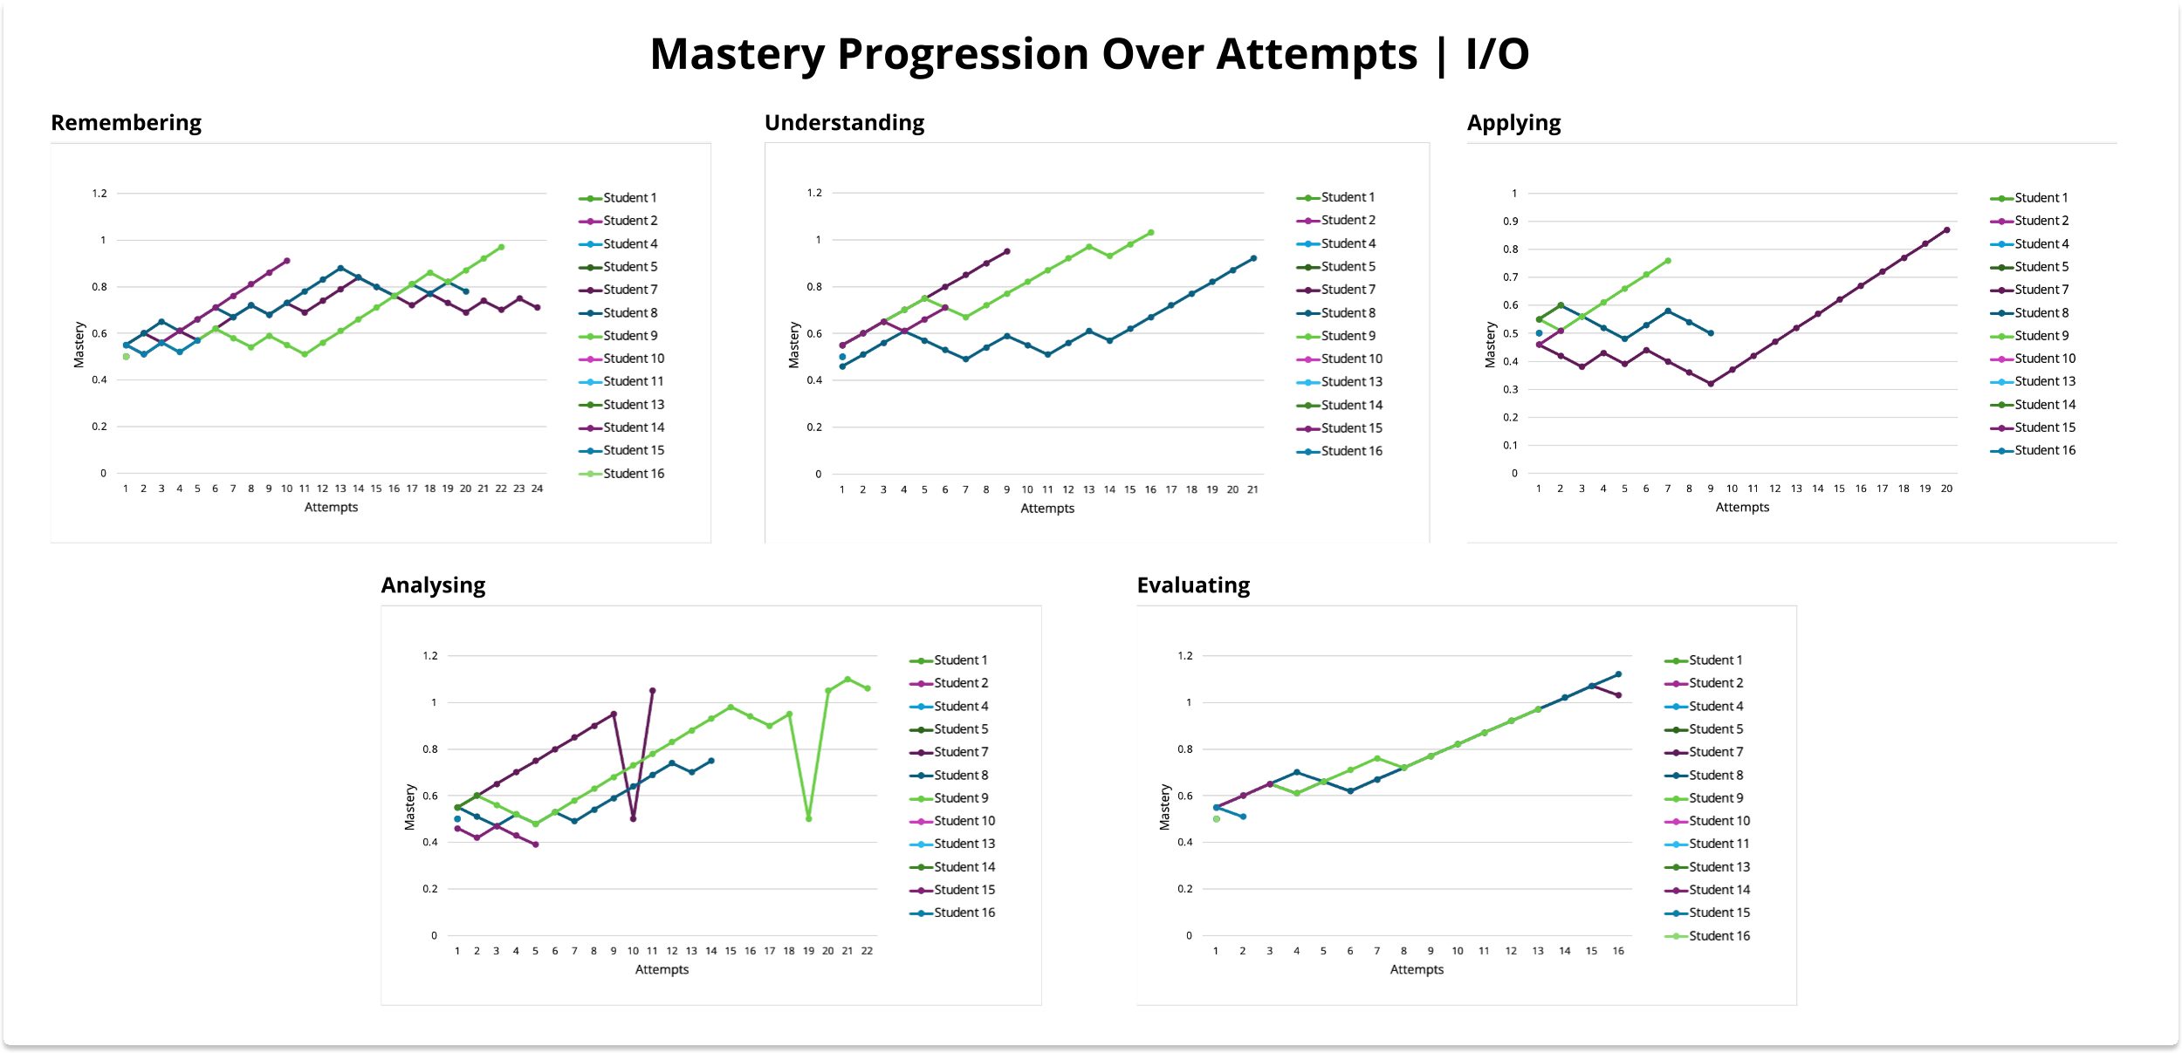
Results & Findings
References
Code
Repository

Slide 27
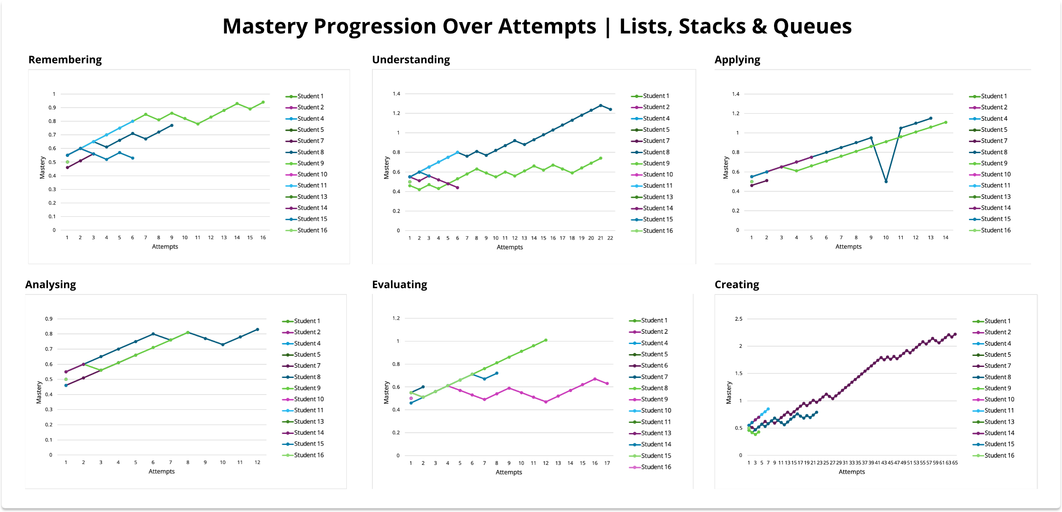
Results & Findings
References
Code
Repository

Slide 28
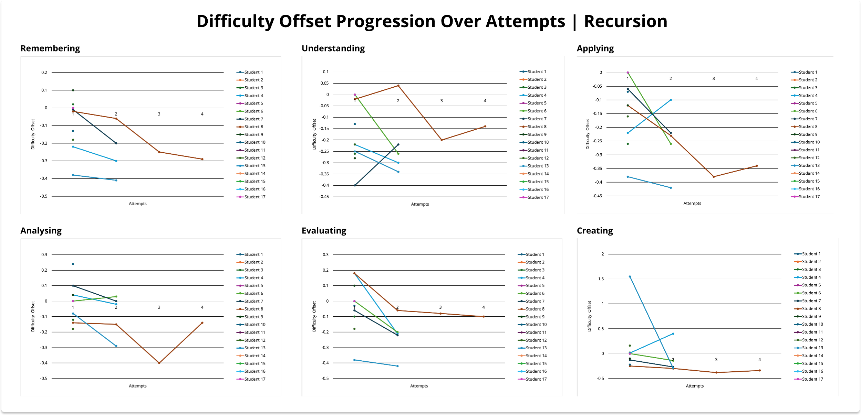
Results & Findings
References
Code
Repository

Slide 29
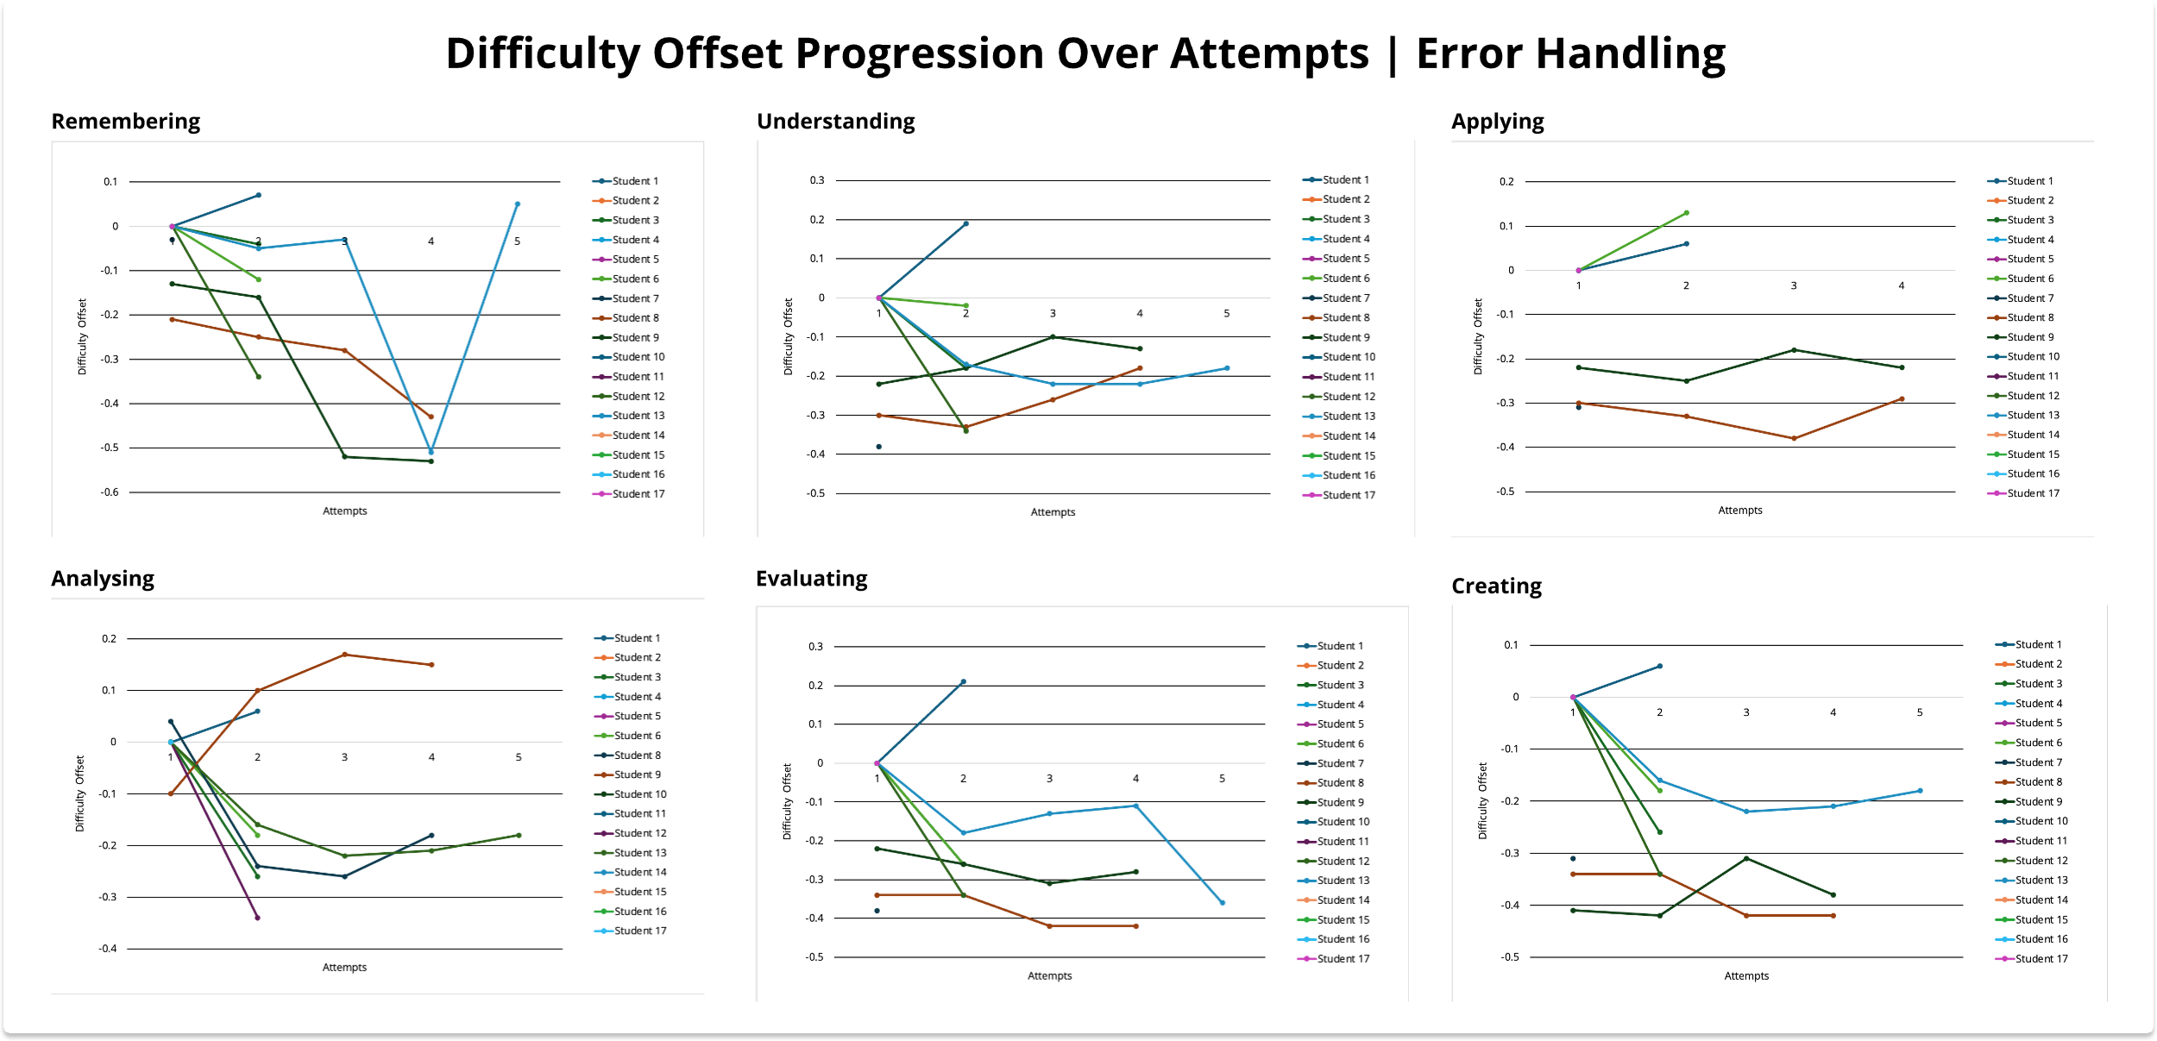
Results & Findings
References
Code
Repository

Slide 30
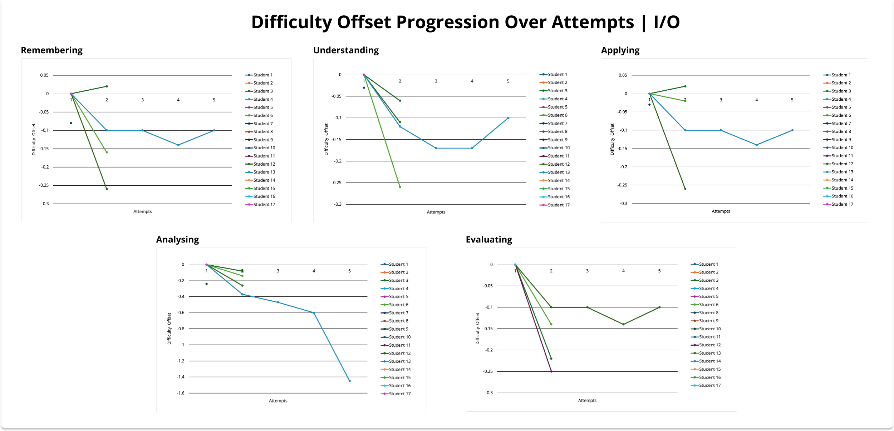
Results & Findings
References
Code
Repository

Slide 31
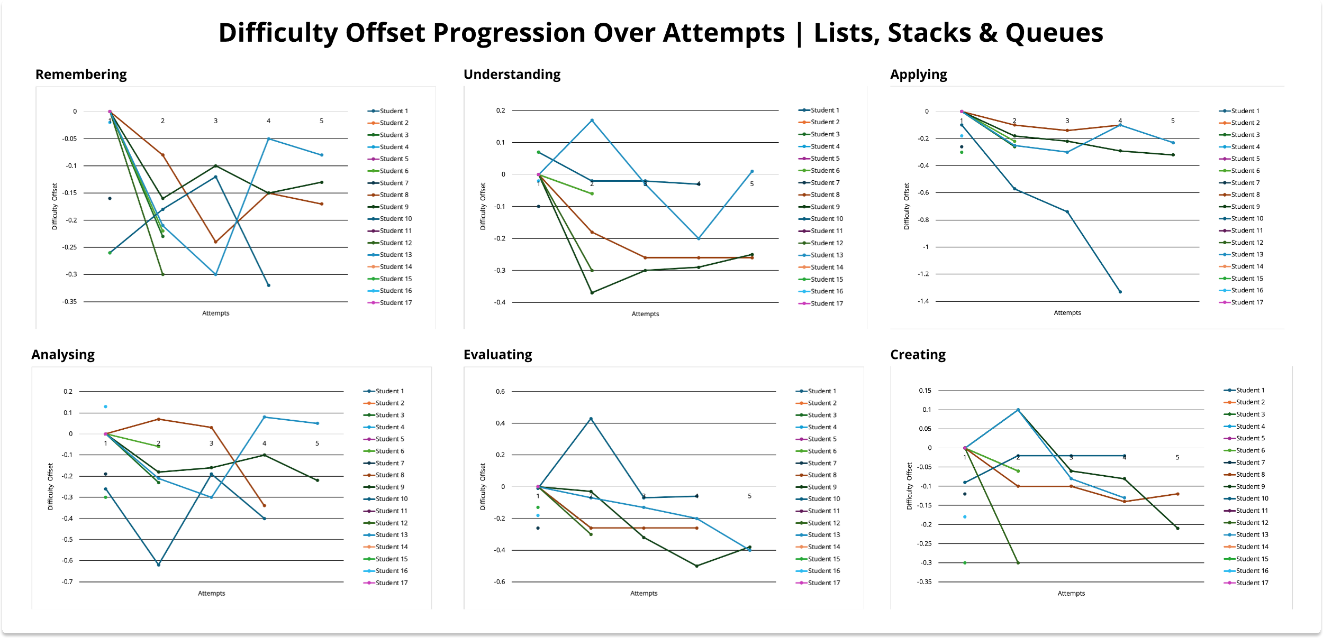
Results & Findings
References
Code
Repository

Slide 32
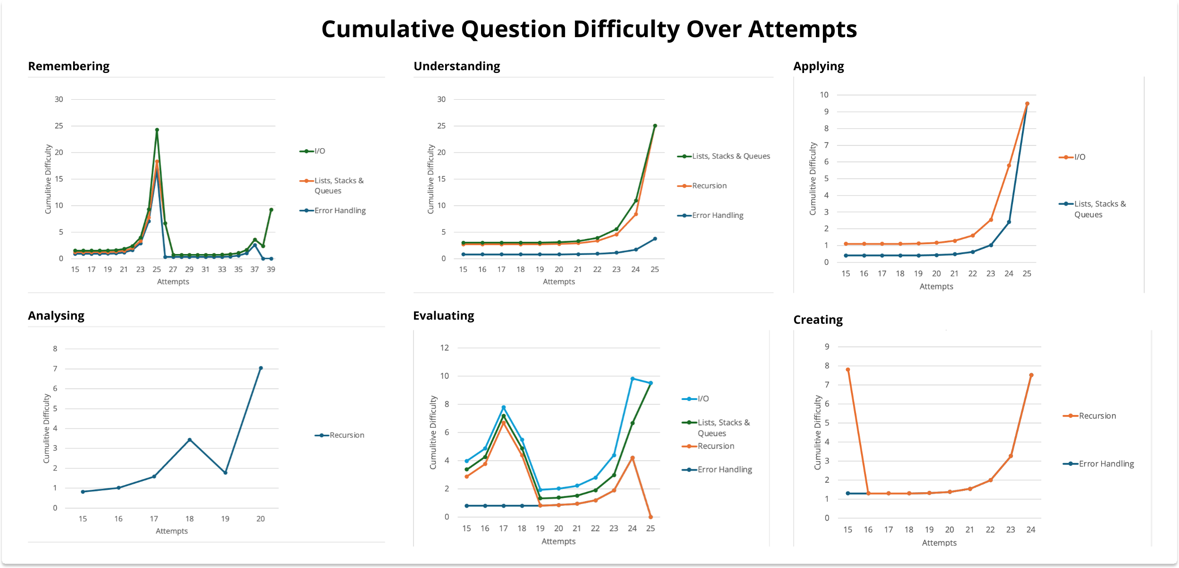
Results & Findings
References
Code
Repository

Slide 33
Chapter 7
Discussion
References
Code
Repository

Slide 34
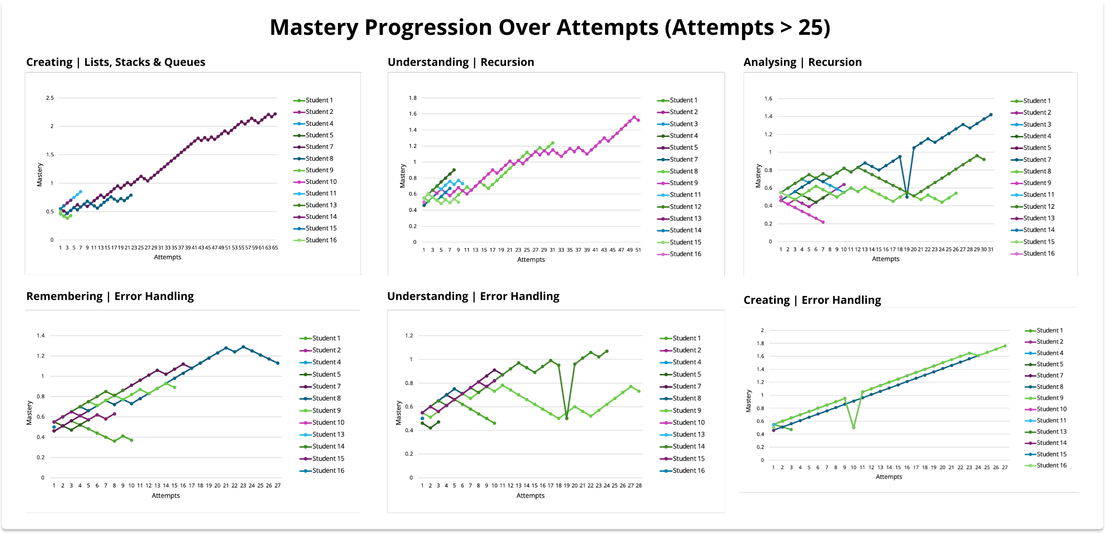
References
Code
Repository

Slide 35
References
Code
Repository

Slide 36
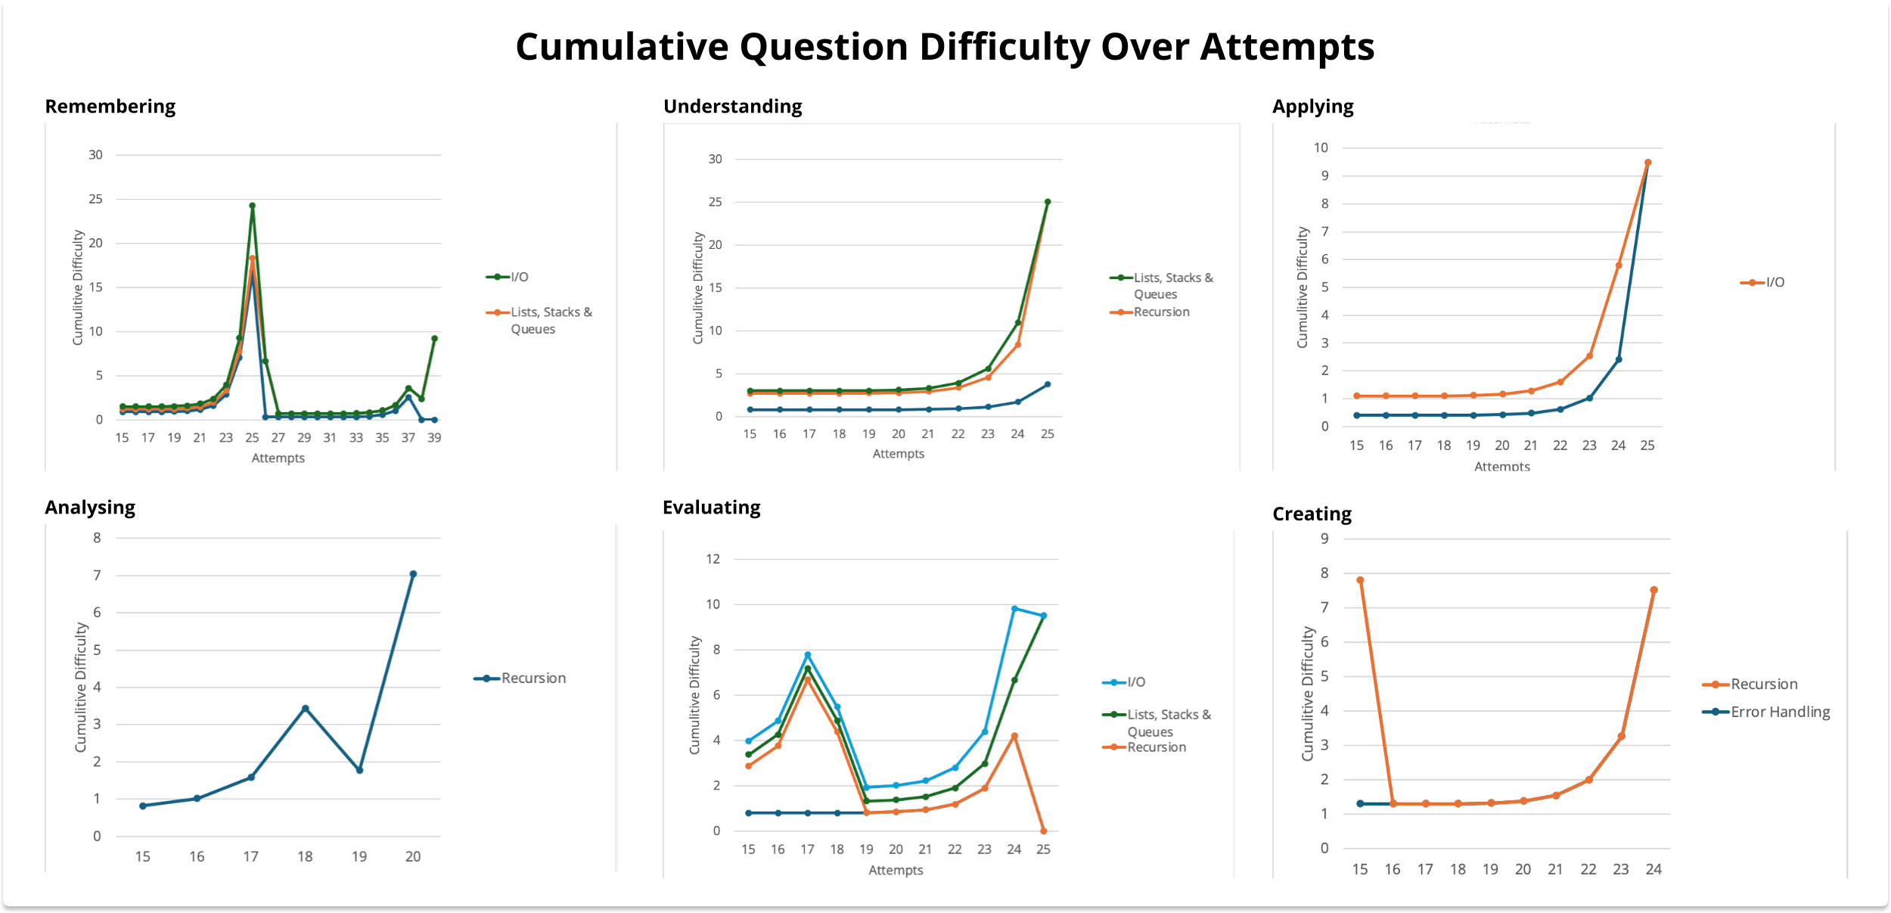
References
Code
Repository

Slide 37
System Usage
References
Code
Repository

Slide 38
Student Feedback
Code
Repository
Strongly Disagree
Disagree
Neutral
Agree
Strongly Agree
References

Slide 39
Chapter 8
Limitations & Future Work
References
Code
Repository

Slide 40
Limitations
Data Size: The data collected from this study is not sufficient to draw robust conclusions. More data will need to be collected to definitively evaluate the effectiveness of the system.
Question Selection: The parameters for selecting questions were not fully optimized.
External Factors: Given that participation in the study was incentivized with bonus marks and did not mandate accurate quiz completion, there may have been instances where students rushed through quizzes, selecting answers indiscriminately.
References
Code
Repository

Slide 41
Further Study
Explore other IRT Models: IRT is a family of Mathematical models. Possibly try exploring the use of a 3-PL or higher IRT Model.
Optimize Question Select Parameters: Further, evaluate and determine the best value for parameters responsible for question selection.
Secondary Student Incentives: Find internal ways to incentivise students to use the tool through the inclusion of rewards, inter-student rankings, and more v.s external incentives, such as bonus marks.
References
Code
Repository

Slide 42
Thank You for Listening
Any Questions?
References
Code
Repository

Slide 43
Why is this Important?
Personalized: This system considers your performance when recommending questions.
Efficient Resource Utilization: By aggregating question difficulty adjustments at the topic level, the system optimizes resource utilization.
Real-time Feedback and Adaptation: The system provides real-time feedback to students on their performance.
Potential for Further Refinement: As a proof-of-concept for utilizing IRT in this capacity, the system offers opportunities for ongoing improvements, including fine-tuning parameters for enhanced performance.
References
Code
Repository

